Slide 1


Gerson Hauwanga
12.09.2023

Slide 2

Outline
Executive Summary
Introduction
Methodology
Results
Conclusion
Appendix

Slide 3
Executive Summary
Using data science mechanisms to predicting the success rate of SpaceX Falcon 9 rockets
Summary of methodologies
Data collection from different data sources
Data processing and cleaning
Exploring Data Analysis with data visualization
Exploratory Data Analysis with SQL
Using Folium to build interactive map
Creating Dashboard using Plotly Dash
Predictive analysis using Classification algorithm
Summary of all results
Analysis of results
Presentation of interactive data analysis results
Predictive analysis result data insights

Slide 4
Introduction
Project background and context
The mail goal for this project is to employ data science mechanisms and methodologies such as data gathering, processing, and virtualization with the help of different machine learning algorithms and apply it to a really world project SpaceX Falcon 9 in order to get insights from data to be able to predict its first stage launchers success rate and thus reusal since SpaceX reuse their lauchers. The results of this analysis would help in determining cost for individual launches.
Problems you want to find answers
Determine whether first stage launchers of Falcon 9 will be successful.
Determine the how different variables impact the success rate.
Determine if success rate increase with time.
Determine whether launch sites and success rates.

Slide 5

Section 1

Slide 6
Methodology
Data collection methodology:
Using SpaceX API and Web Scraping SpaceX Falcon 9 launch records data from Wikipedia pages
Perform data wrangling
Cleaning and structuring data in order to deal with missing data
Filter data according and eliminate all unnecessary data to suit the project needs
Perform exploratory data analysis (EDA) using visualization and SQL
Perform interactive visual analytics using Folium and Plotly Dash
Perform predictive analysis using classification models
Build, tune, evaluate classification models for better results

Slide 7
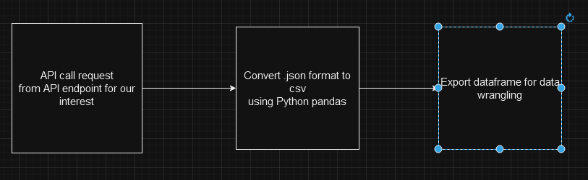
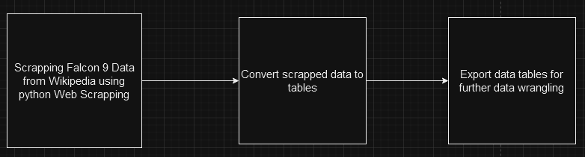
Data Collection
Data was collected from SpaceX launch records API end points and Web scraping falcon 9 records.
The data results are in json format and need to be converted into CSV before using them in the project.
The process of SpaceX data collection
API calls on SpaceX falcon 9 data end points
Www.github.com/user/lab1
Wikipedia web Scraping
Www.github.com/user/lab2

Slide 8
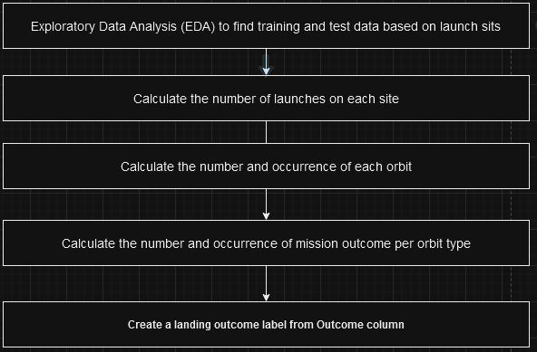
Data Wrangling
At first the data from the API and web scraping are always in raw form. Contain too much noise such missing columns, duplicates and wrongly labeled column data types therefore, the data need to be data need to be cleaned and structured and replace missing data. In that process, the tuned data would then be divided into 2 categories as training and test data.
API calls on SpaceX falcon 9 data end points
Www.github.com/user/lab1

Slide 9
EDA with Data Visualization
Using pandas and Matplotlib, I was able to plot chart and get insight on the data and find success.
Scatter plots based to show how Flight Number vs. Payload Mass,Flight Number vs. Launch Site, Orbit vs. Payload Mass, and Payload Mass vs. Lauch Site variables determine the success rate of the successful landing.
Bar Chart for determining the success rate of landing by comparing Class and Orbit.
Line Chart to indicate a trend of success landings in a year.
Www.github.com/name/link

Slide 10
EDA with SQL
SQL data manipulation was carried out to
Display the names of the unique launch sites in the space mission
Display 5 records where launch sites begin with the string 'CCA'
Display the total payload mass carried by boosters launched by NASA (CRS)
Display average payload mass carried by booster version F9 v1.1
List the date when the first successful landing outcome in ground pad was achieved
List the names of the boosters which have success in drone ship and have payload mass greater than 4000 but less than 6000
List the total number of successful and failure mission outcomes
List the names of the booster_versions which have carried the maximum payload mass. Use a sub query
Rank the count of landing outcomes (such as Failure (drone ship) or Success (ground pad)) between the date 2010-06-04 and 2017-03-20, in descending order.
Www.github.com/name/link

Slide 11
Build an Interactive Map with Folium
In this task, the goal was to mark launch sites on the the interactive map and indicate the success/failed launches using folium python package markers, circles and lines.
The main tasks where to:
Mark all launch sites on a map
Mark the success/failed launches for each site on the map
Calculate the distances between a launch site to its proximity
Www.github.com/hijdjjds/user

Slide 12
Build a Dashboard with Plotly Dash
Using Plotly Dashboards and dash pi-charts
to indicate the success rate for all sites and comparing that to the failed rates.
This was done to show which site has the most success launches.
Github.com

Slide 13
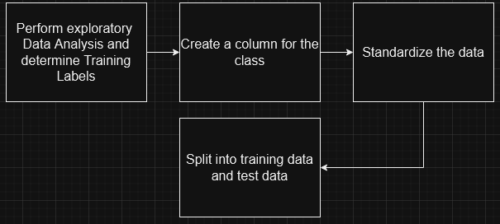
Predictive Analysis (Classification)
Using data analysis classification model to be able to predict future launch success rates.
Www.github.com

Slide 14
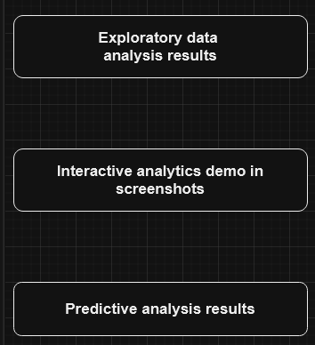
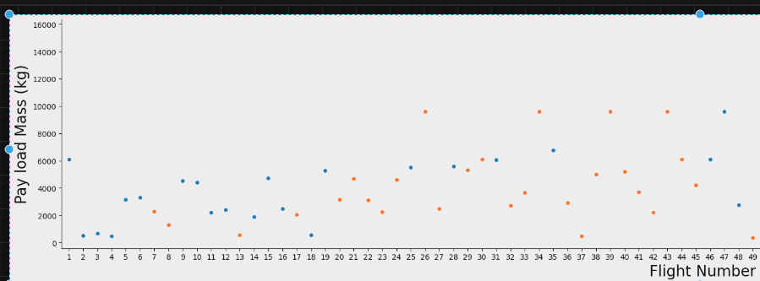
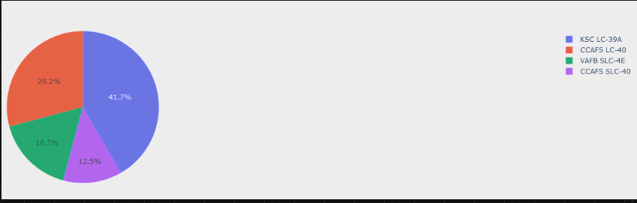
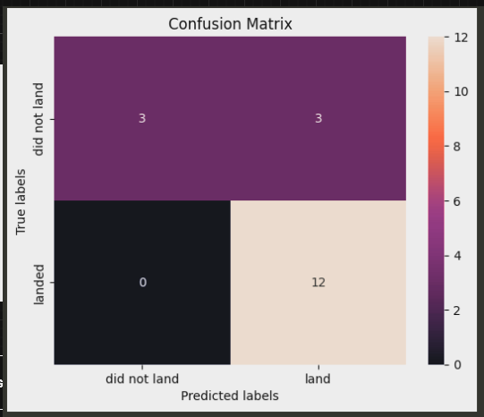
Results

Slide 15

Section 2

Slide 16
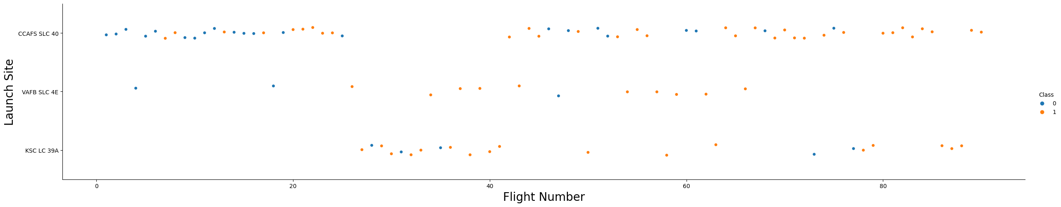
Flight Number vs. Launch Site
We see that different flight numbers have different success rates per each launch sites. CCAFS LC-40, has better success flight, while KSC-LC-39A and VAFB-SLC-4E are slightly lower

Slide 17
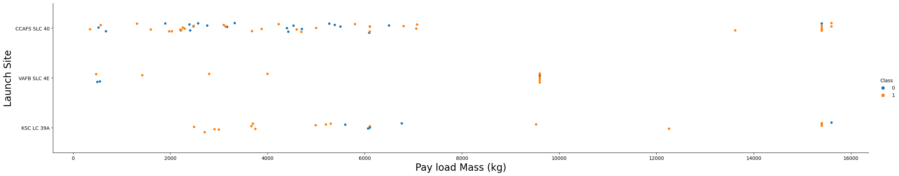
Payload vs. Launch Site
For launch site VAFB-SLC there were no rockets launched for heavy payload mass(greater than 10000)
For launch site CCAFS SLC 40, there were a higher number of successful flights of lower payload mass less than ~7000.

Slide 18
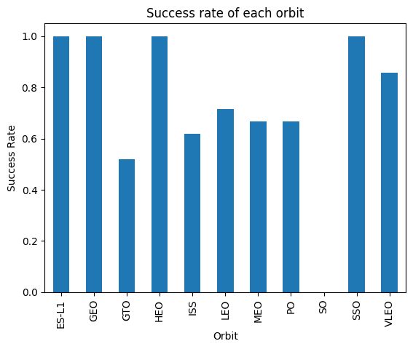
Success Rate vs. Orbit Type
Orbits ES-LI, GEOm HEO, and SSO have highest the success flight rate while GTO is lowest.

Slide 19
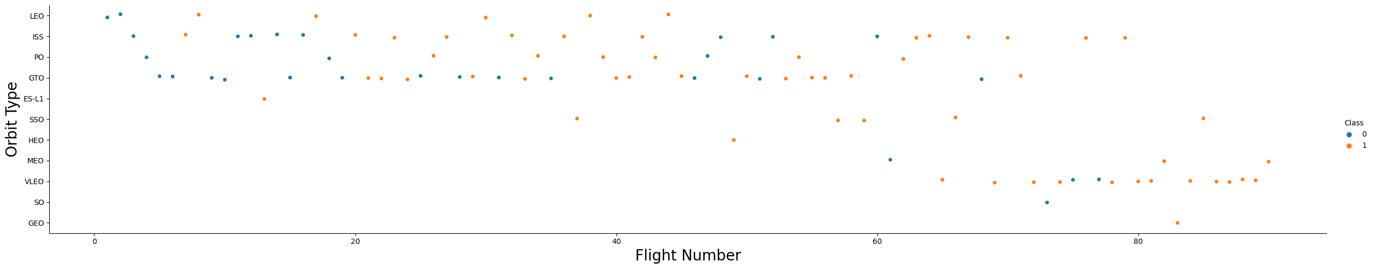
Flight Number vs. Orbit Type
There was only one success landing for GEO at flights after 80, GTO, ISS, LEO PO had great but random successful landing.

Slide 20
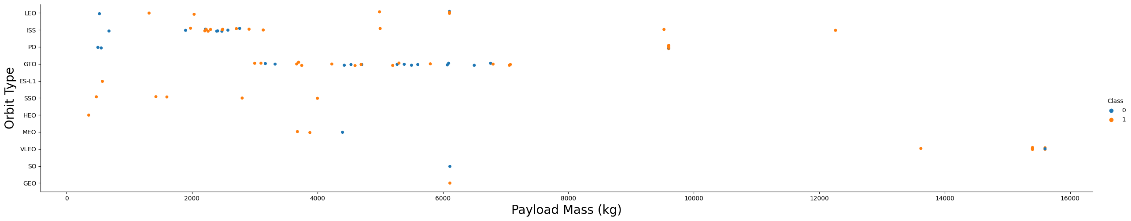
Payload vs. Orbit Type
Heavy payload mass had lower success rate for all orbits.
There was no successful landing for weight over 16000.
With heavy payloads the successful landing or positive landing rate are more for Polar,LEO and ISS.

Slide 21
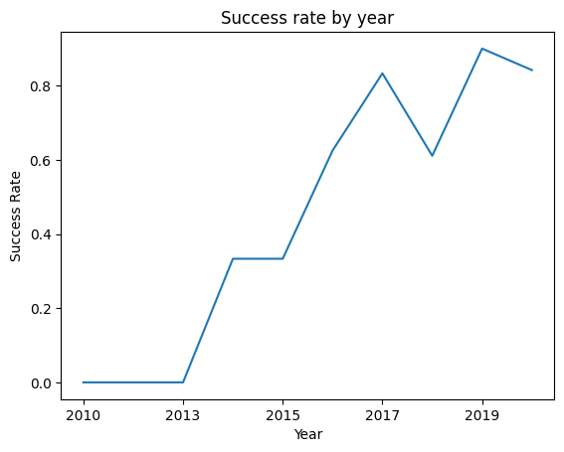
Launch Success Yearly Trend
The success rate since 2013 kept increasing till 2020. That means success was a result of improvements and repetition

Slide 22
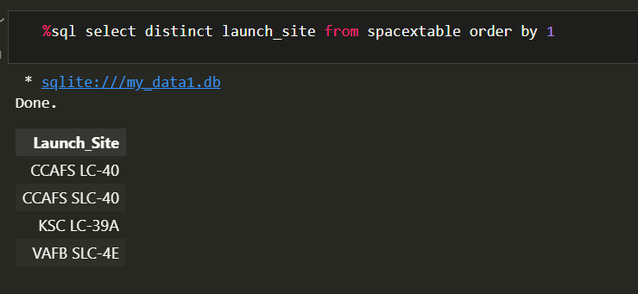
All Launch Site Names

Slide 23
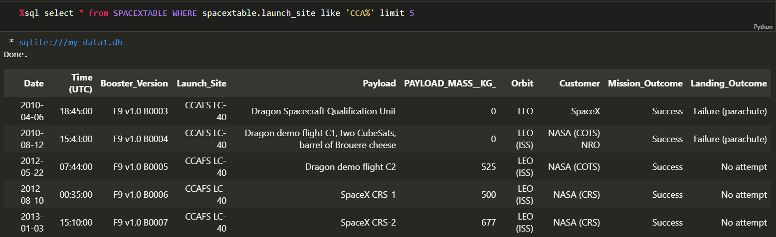
Launch Site Names Begin with 'CCA'

Slide 24
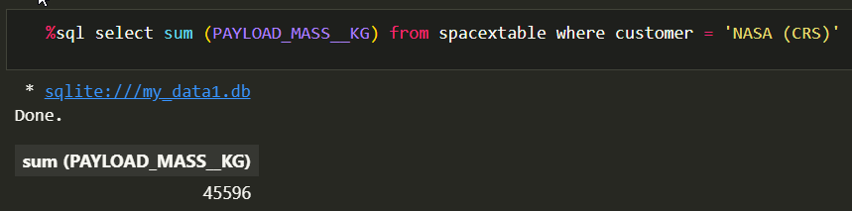
Total Payload Mass

Slide 25
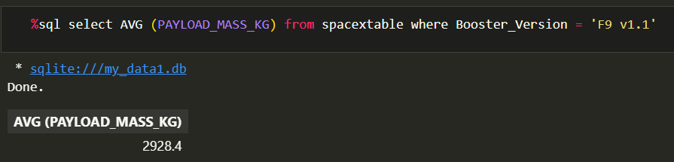
Average Payload Mass by F9 v1.1

Slide 26
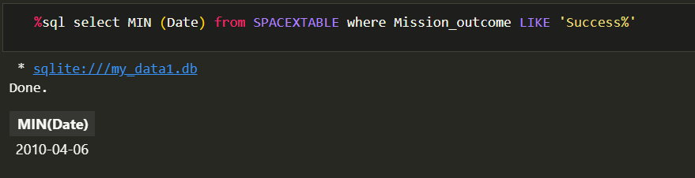
First Successful Ground Landing Date

Slide 27
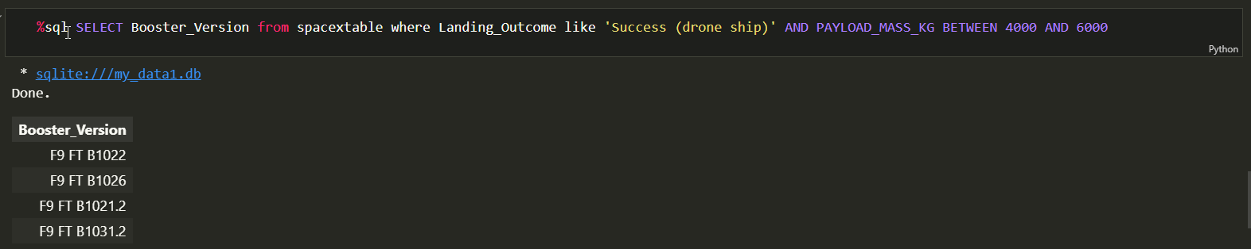
Successful Drone Ship Landing with Payload between 4000 and 6000

Slide 28
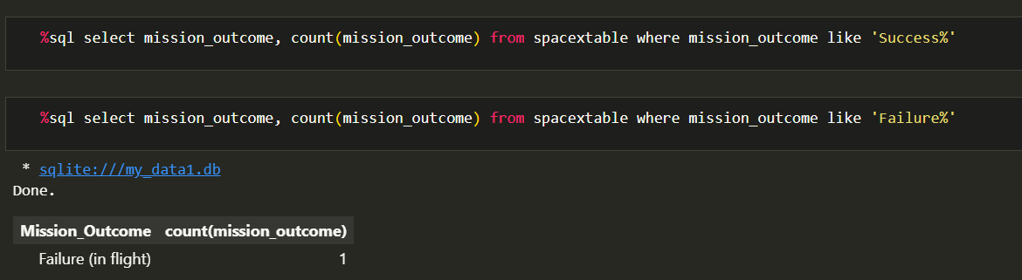
Total Number of Successful and Failure Mission Outcomes

Slide 29
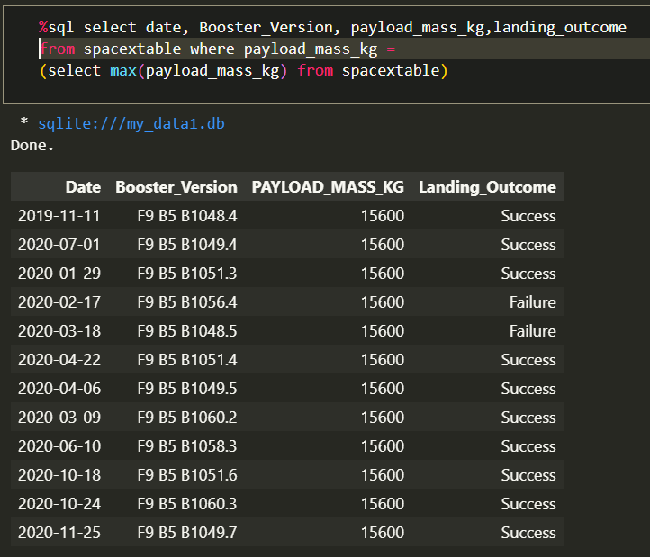
Boosters Carried Maximum Payload

Slide 30
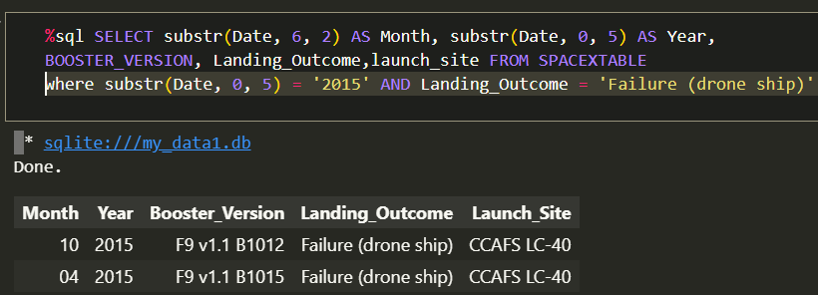
2015 Launch Records

Slide 31
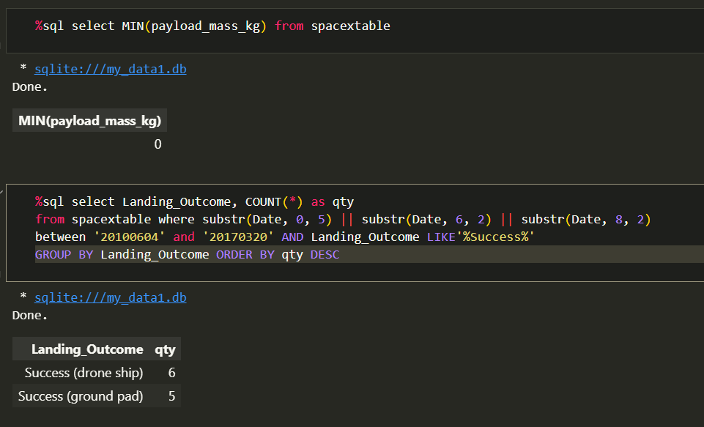
Rank Landing Outcomes Between 2010-06-04 and 2017-03-20

Slide 32

Section 3

Slide 33
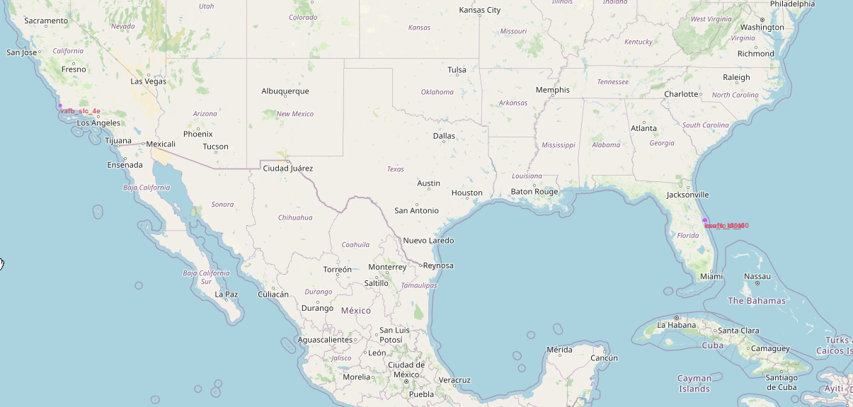
Mark all launch sites on a map
All launch sites were nearby the coastal line

Slide 34
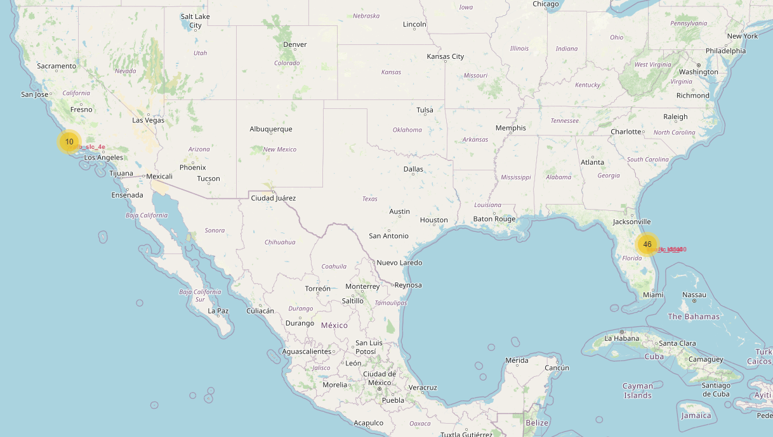
Mark the success/failed launches for each site on the map
East coast launch sites, KSC-LC-39A, CCAFS-LC-40 and CCAFS-SLC-40 had a many failed/success launches compared to the western coast.

Slide 35
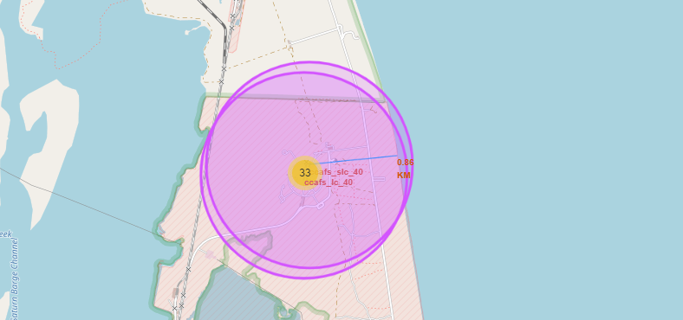
Calculate the distances between a launch site to its proximities
2x East coastal launch sites are in proximity with about 33 point of interest and also nearby the ocean.

Slide 36

Section 4

Slide 37
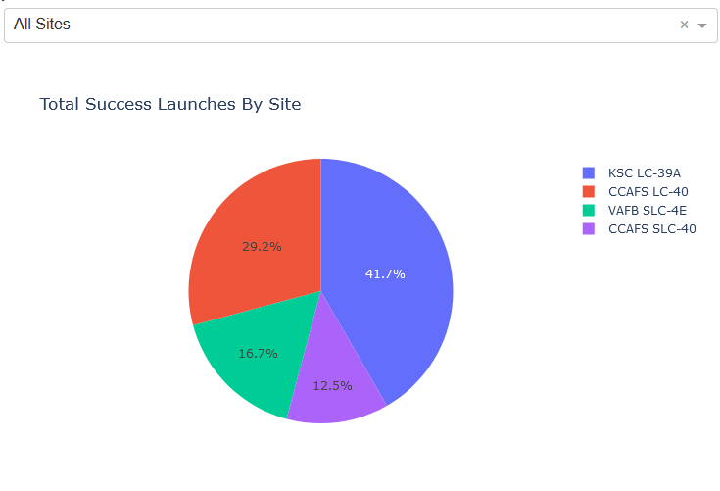
SpaceX Launch Records Dashboard
KSC LC – 39A had the highest successful launches and CCAFS SLC- 40 had the lowest

Slide 38
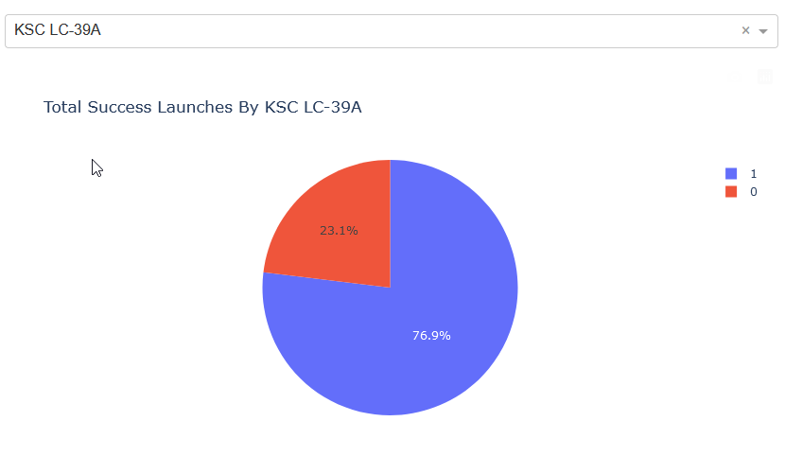
Total success Launches by KSC LC-39A
High success was of class 1 compered to class 0 with the lowest success rate.

Slide 39
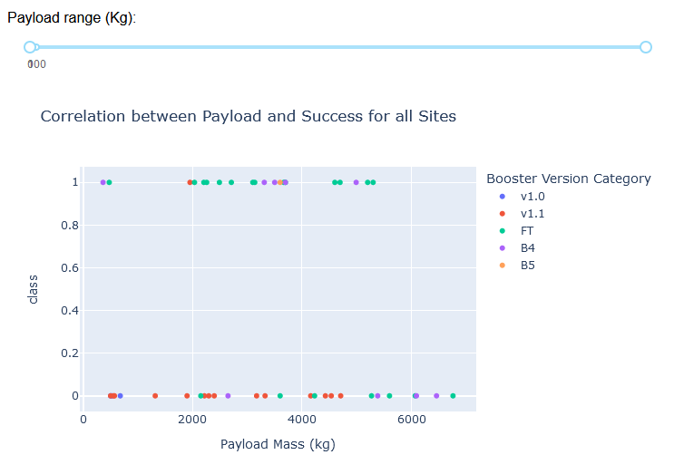
Correlation between Payload and Success for all Sites

Slide 40

Section 5

Slide 41
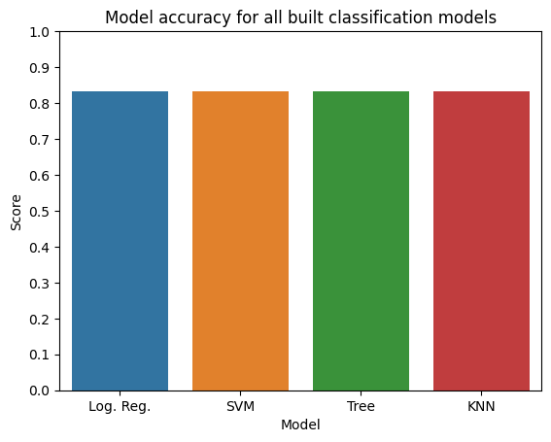
Classification Accuracy
All models have similar accuracy

Slide 42

Confusion Matrix
Examining the confusion matrix, we see that logistic regression can distinguish between the different classes. We see that the major problem is false positives.

Slide 43
Conclusions
On classification algorthims, the decision tree is a suitable choice for this project.
Based on the results, the lower the payload mass the higher the success rate. We can rule that the lighter the better.
Another point is that, the rate of success seem to increase with time and repetition. As for the launch sites, KSC LC-39A has many success launch/landing compared to others.

Slide 44
Appendix
Include any relevant assets like Python code snippets, SQL queries, charts, Notebook outputs, or data sets that you may have created during this project

Slide 45


